Slide 1
SQL
Capstone
Project
02/10/2025
Samuel asante- July 2025

Slide 2
NextGen the business Overview
NextGen Corp is a rapidly growing technology company specializing in innovative software and hardware solutions. While the company excels at attracting top talent and fostering employee satisfaction, it faces challenges with rising turnover, inconsistent performance across departments, and salary disparities that may impact fairness and morale.
To sustain growth and maintain a high-performing workforce, NextGen Corp. needs a data-driven approach to monitor retention trends, evaluate performance, and ensure compensation aligns with employee contributions. Addressing these issues will help optimize workforce effectiveness, retain key talent, and support continued business success.

Slide 3
Key Terms Used in the Capstone
Employee Retention; Employee Turnover
Performance Score; Salary; Attendance Rate, Turnover Rate & Data-Driven Insights

Slide 4
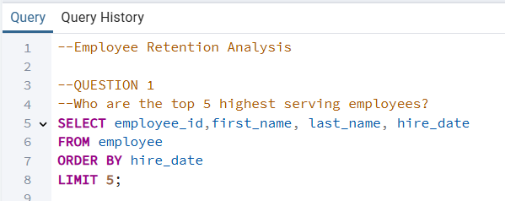
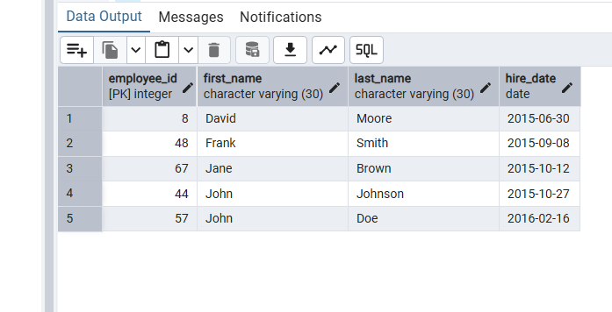
Employee Retention Analysis q1 the top 5 highest serving employees

Slide 5
strategic insights derived
The top 5 highest-serving employees are pillars of organizational stability and expertise, but they also represent a potential risk concentration if engagement or compensation misaligns. By leveraging their experience through mentorship, rewarding their loyalty, and reintroducing the retention strengths from NextGen’s early years, the company can strengthen both employee satisfaction and long-term organizational continuity.

Slide 6
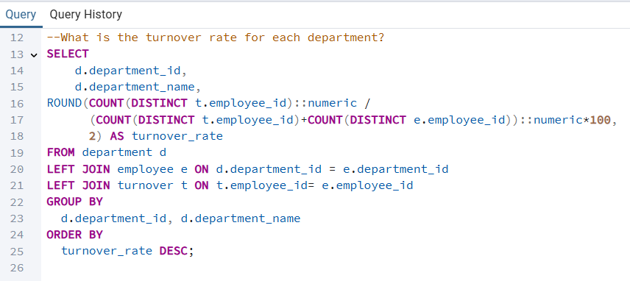
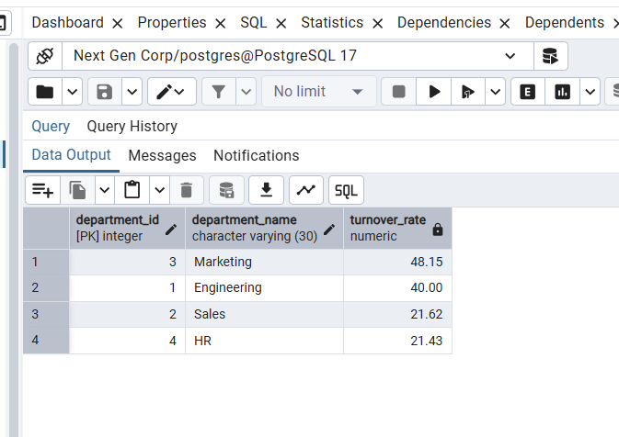
Employee Retention Analysis q2 The turnover rate for each department

Slide 7
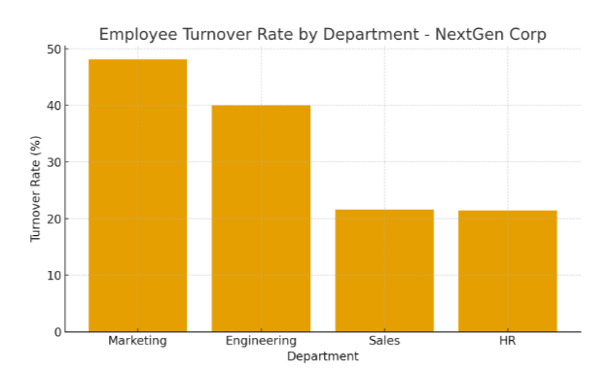
Strategic insights derived from tHIS data
NextGen Corp’s data shows high turnover in Marketing (48.15%) and Engineering (40%), while Sales (21.62%) and HR (21.43%) have lower rates. This suggests issues with workload, growth opportunities, or pay in the higher-turnover areas. The company should focus on improving retention, career development, and compensation in Marketing and Engineering to boost stability and reduce turnover costs.

Slide 8
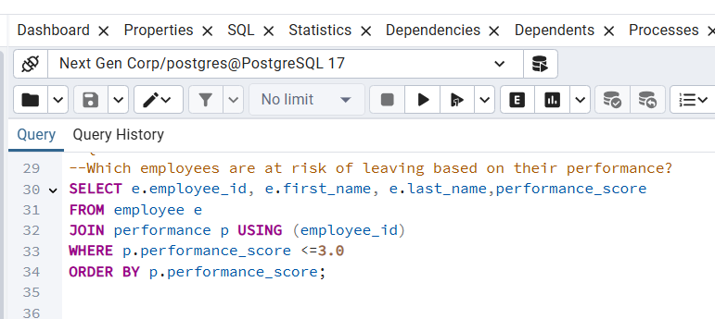
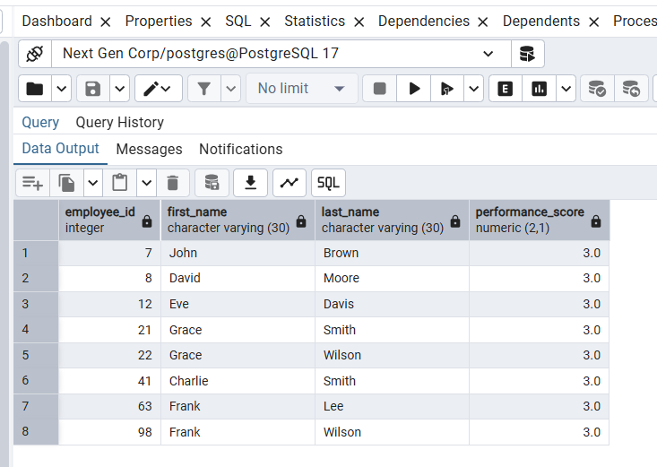
Employee Retention Analysis q3 Employees who are at risk of leaving based on their performance

Slide 9
Strategic insights derived from tHIS data
This data also shows that all these eight employees have a performance score of 3.0, indicating they are performing at an average level. This uniform score suggests a potential engagement or motivation issue, as consistently mid-level performance can be an early warning sign of disengagement or dissatisfaction, putting these employees at risk of leaving. Strategically, NextGen Corp should focus on re-engaging these employees through performance feedback sessions, clearer career growth paths, and recognition programs. Providing targeted development opportunities and discussing individual goals can help improve their performance and commitment, reducing the likelihood of turnover among this group.

Slide 10
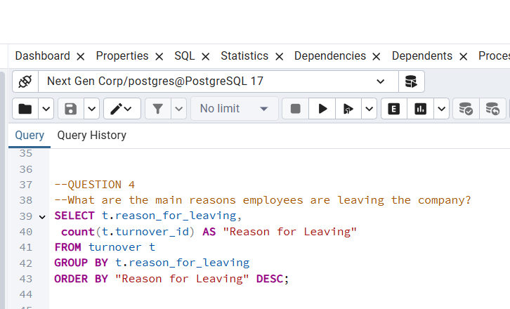
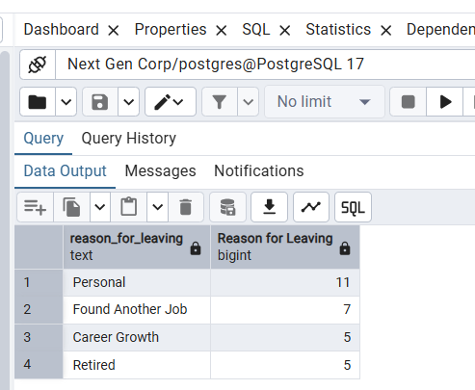
Employee Retention Analysis q4 The main reasons employees are leaving the company

Slide 11
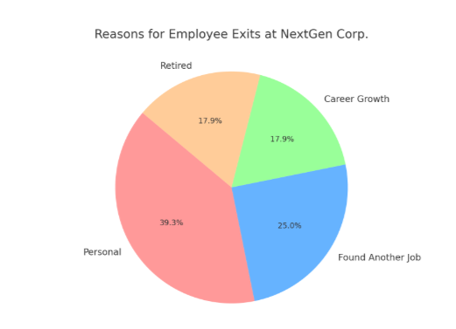
Strategic insights derived from tHIS data
The data shows that most employees leave NextGen Corp for personal reasons (11 cases), followed by finding another job (7) and career growth or retirement (5 each). This pattern indicates that while some turnover is unavoidable, a significant portion may stem from employees seeking better opportunities or clearer advancement paths. Strategically, NextGen should focus on enhancing career development programs, internal mobility, and flexible work options to address personal and professional needs. By improving work-life balance and career progression opportunities, the company can reduce voluntary exits and strengthen long-term employee retention.
This visual pie chat makes it easier to prioritize strategic interventions, such as flexible work options and enhanced career development programs

Slide 12
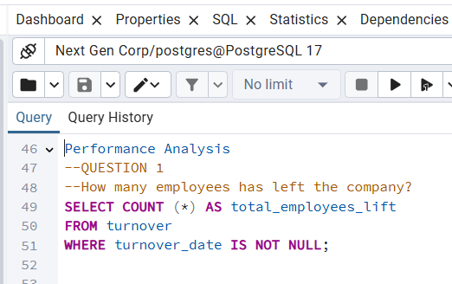
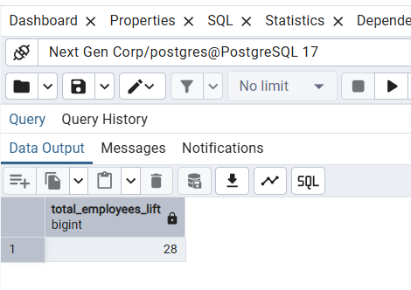
Performance Analysis q1 Number of employees who left company

Slide 13
Strategic insights derived from tHIS data
Analysis of the 28 employee exits reveals that personal reasons are the primary driver of turnover, accounting for nearly 40% of all departures. This suggests that issues related to work-life balance, flexibility, or personal well-being may be significant concerns for employees. The second most common reason, employees leaving for another job, indicates competitive pressures in the labour market which suggesting that some employees may be drawn to better pay or growth opportunities elsewhere. Meanwhile, career growth and retirement each represent about 18% of exits, with the former highlighting potential gaps in internal mobility and advancement. Strategically, NextGen Corp. should focus on strengthening retention by introducing flexible work arrangements, improving internal career progression pathways, and benchmarking compensation against industry standards to remain competitive. Additionally, succession planning and knowledge transfer programs could help mitigate the impact of retirements on organizational continuity.

Slide 14
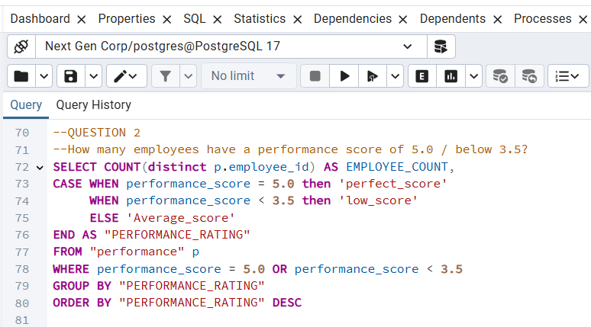
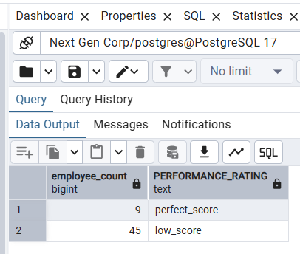
Performance Analysis q2 Number of employees performance between 5.0 / below 3.5

Slide 15
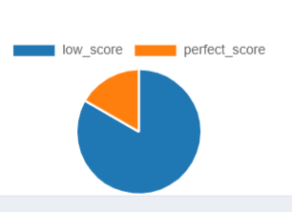
Strategic insights derived from tHIS data
The performance data shows that only 9 employees achieved a perfect score of 5.0, while 45 employees received a lower score of 3.5. This indicates that overall performance levels may be below expectations, suggesting potential gaps in motivation, training, or performance management. The small group of high performers could be used as role models or mentors to help improve team performance across the company. Strategically, NextGen Corp. should focus on identifying the factors driving high performance—such as skill level, management support, or engagement—and apply these insights to underperforming groups. Implementing targeted training programs, setting clearer performance goals, and recognizing top performers can help raise overall productivity and engagement.

Slide 16
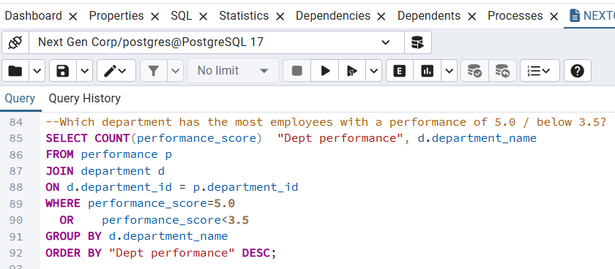
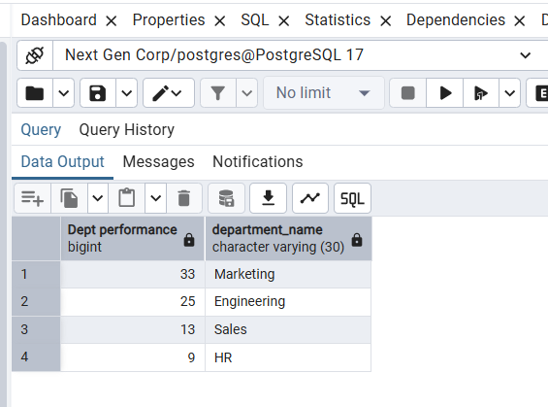
Performance Analysis q3 Department WHICH HAS the most employees with a performance of 5.0 / below 3.5

Slide 17
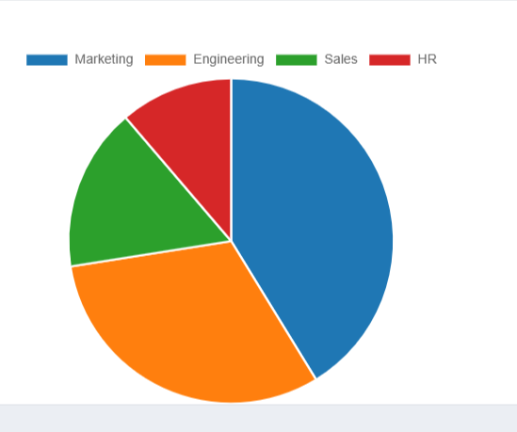
Strategic insights derived from tHIS data
Based on the data, the Marketing department has the highest number of employees with performance scores of 5.0 or below 3.5, totaling 33 employees. This suggests significant performance variability within the department when some employees are excelling while others may be struggling to meet expectations. The Engineering department follows with 25 employees, indicating potential skill or workload challenges, while Sales (13) and HR (9) show relatively smaller performance gaps. Strategically, NextGen Corp. should focus on understanding the root causes of inconsistent performance in Marketing such as leadership effectiveness, training gaps, or workload imbalance. Implementing targeted performance improvement plans, mentorship programs, and skill enhancement workshops could help lift low performers while maintaining motivation for high achievers. Regular performance reviews and data-driven monitoring would also help ensure consistent progress across departments.

Slide 18
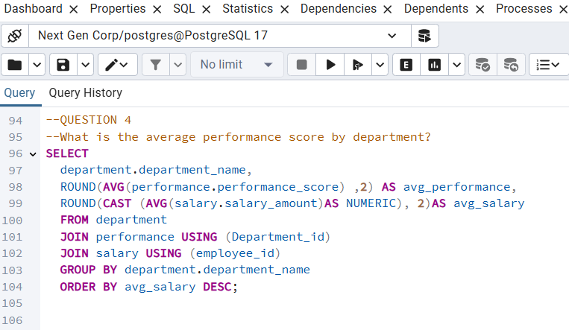
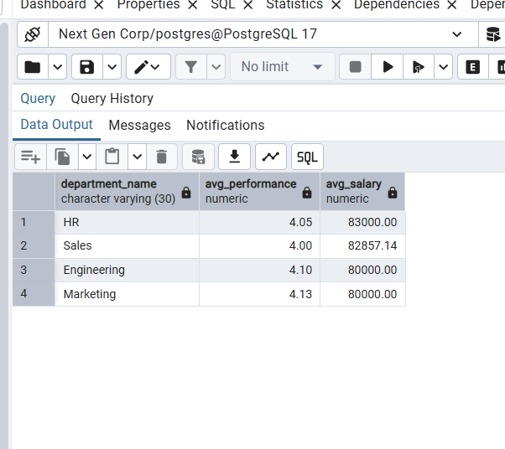
Performance Analysis q4. Average performance score by department

Slide 19
Strategic insights derived from tHIS data
The data shows that Marketing leads with the highest average performance score of 4.13, followed closely by Engineering (4.10), HR (4.05), and Sales (4.00). Interestingly, both Marketing and Engineering have similar average salaries at $80,000, yet their performance is higher than HR and Sales, whose salaries are slightly higher—around $83,000. This suggests that higher pay is not directly translating to better performance in HR and Sales, implying that other factors such as motivation, team culture, or leadership may play a more significant role. Strategically, NextGen Corp. should evaluate whether salary structures align with performance outcomes and consider introducing performance-based incentives or recognition programs. Additionally, exploring what drives higher productivity in Marketing and Engineering—such as better management practices, clearer goals, or employee engagement—can help replicate these strengths across lower-performing departments.

Slide 20
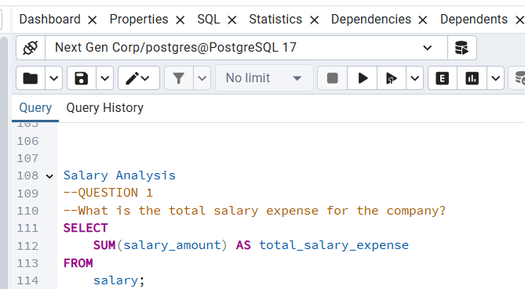
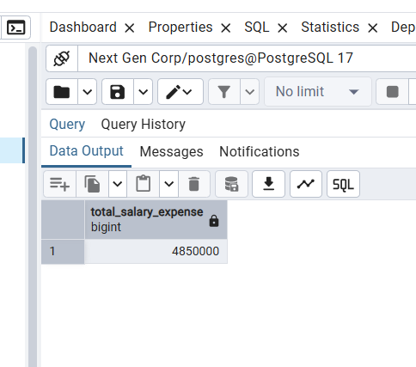
Salary Analysis q1. The total salary expense for the company

Slide 21
Strategic insights derived from tHIS data
The company’s total salary expense of $4,850,000 shows a large investment in its workforce, but the data suggests that higher pay does not always mean higher performance. Marketing and Engineering employees have strong average performance scores despite having lower average salaries, while HR and Sales earn slightly more but perform a bit lower. This means money alone may not be the main driver of good performance. To get better results from this investment, NextGen Corp. should focus on non-monetary motivators like better training, clearer goals, recognition programs, and career growth opportunities. At the same time, the company should review its pay-for-performance strategy to make sure salary and performance are more closely linked, ensuring fairness and better motivation across all departments.

Slide 22
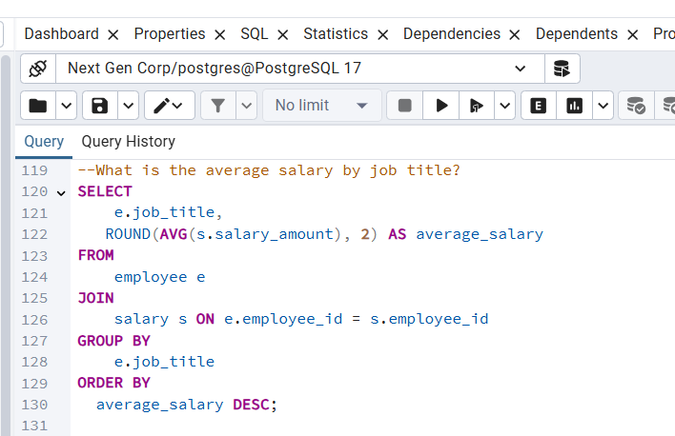
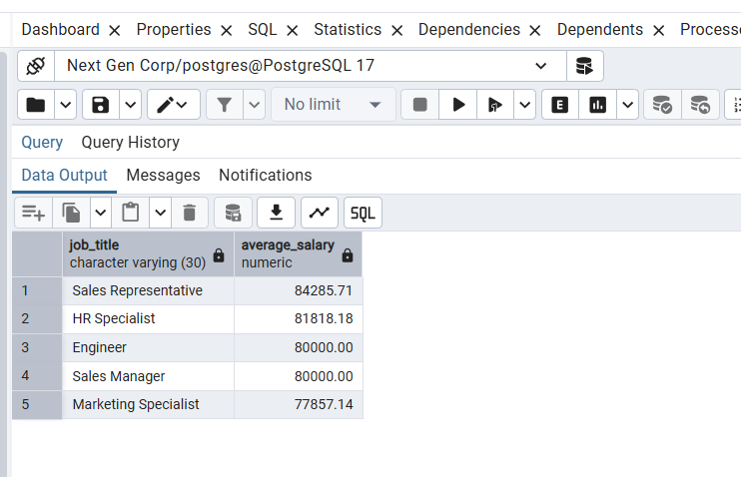
Salary Analysis q2 The average salary by job title

Slide 23
Strategic insights derived from tHIS data
The data shows that Sales Representatives earn the highest average salary ($84,285.71), while Marketing Specialists earn the lowest ($77,857.14). Despite similar pay for Engineers and Sales Managers ($80,000), performance data suggests Marketing and Engineering achieve stronger results. This indicates some pay-performance imbalance, where higher salaries don’t always lead to better outcomes. NextGen Corp. should review salary structures to ensure fairness, align pay more closely with performance, and consider rewarding high-performing but lower-paid roles like Marketing Specialists to boost motivation and retention.

Slide 24
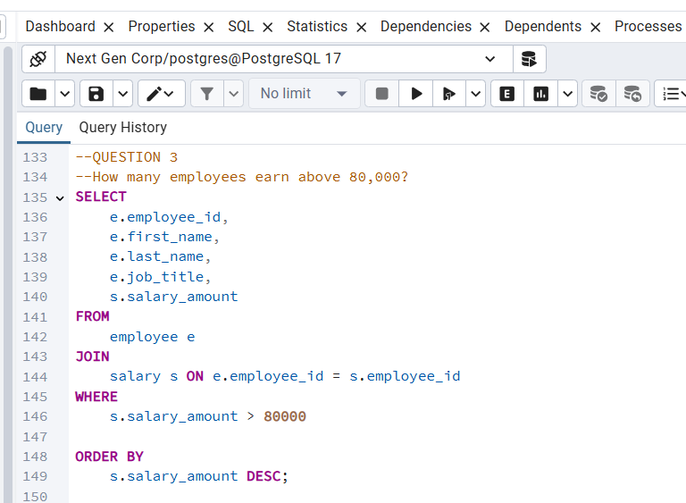
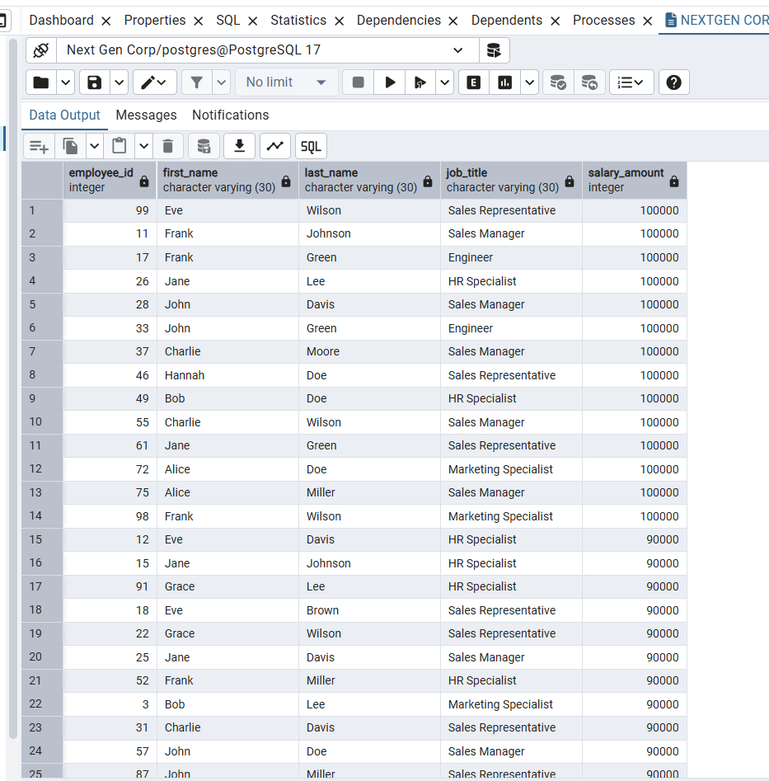
Salary Analysis q3. The number employees earn above 80,000

Slide 25
Strategic insights derived from tHIS data
Out of the workforce, 28 employees earn above $80,000, indicating a notable concentration of higher salaries among a subset of staff. This could highlight potential disparities or a tiered pay structure that may need review for fairness and alignment with performance.

Slide 26
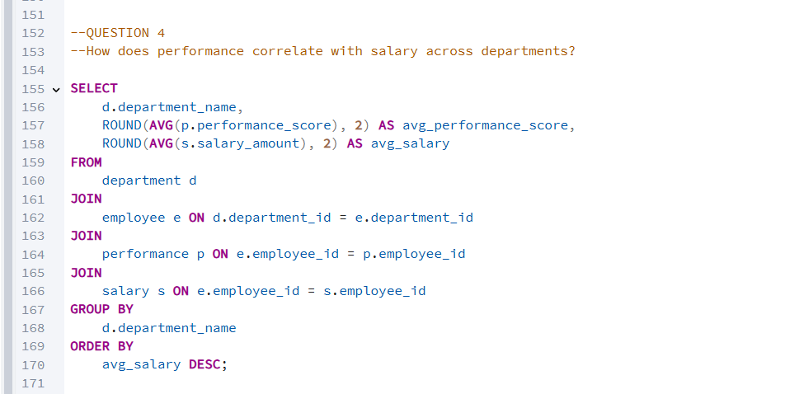
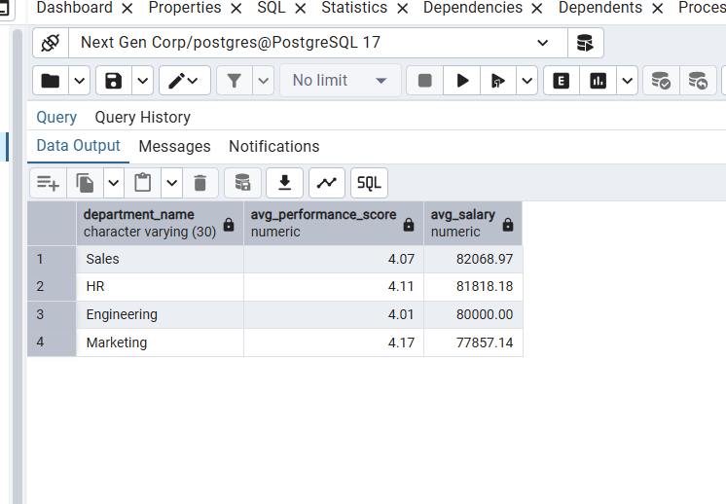
Salary Analysis
Q4. How performance correlate with salary across departments

Slide 27
Strategic insights derived from tHIS data
The data suggests that higher salaries do not directly correspond to higher performance. Marketing has the highest performance score (4.17) despite the lowest average salary, while Sales and HR earn more but perform slightly lower (4.07 and 4.11). Engineering falls in the middle. This indicates that factors other than salary—such as work environment, recognition, training, and career growth—likely play a stronger role in driving performance. NextGen Corp. may benefit from focusing on non-monetary motivators while ensuring that pay and performance are reasonably aligned for fairness and motivation.

Slide 28
Conclusion
The SQL analysis for NextGen Corp reveals that employee performance does not always align with salary levels across departments, with Marketing and Engineering achieving strong performance despite lower average pay, while HR and Sales earn more but perform slightly lower. This suggests that non-monetary factors such as training, recognition, and career growth significantly influence employee outcomes. To optimize retention, motivation, and fairness, the company should enhance its pay-for-performance strategy and invest in programs that support employee development and engagement.

